Slide 1
Swap ColE1 origin for p15A
2013_08_09 GIBSON - SWAP ORIGIN to p15A on pHps2 RFP pCM66T
https://docs.google.com/spreadsheet/ccc?key=0AlVxrZi130nMdDdqb0JVdHpBLTBwZVZUNjBrMUtlSlE#gid=1

Slide 2
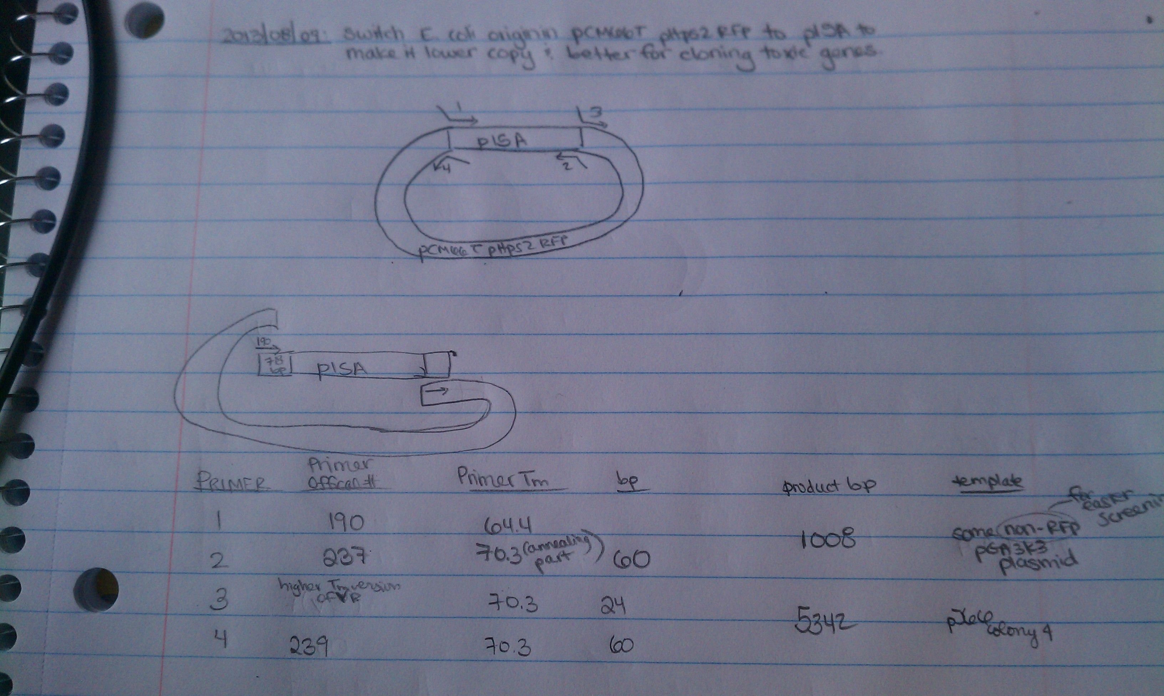

Slide 3
